Slide 1
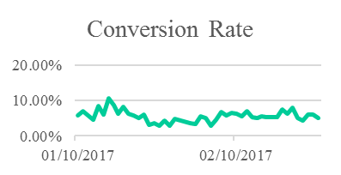
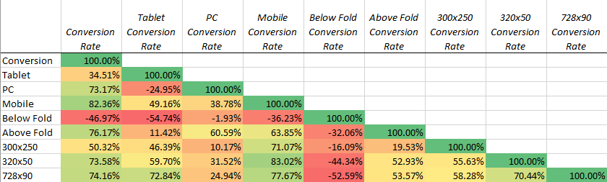
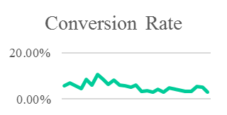
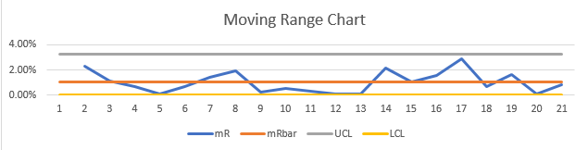
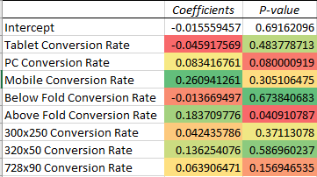
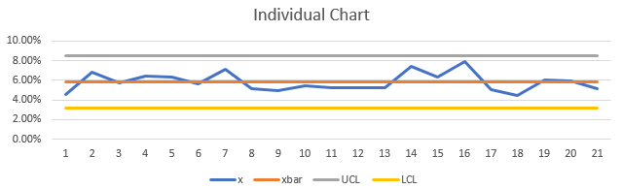
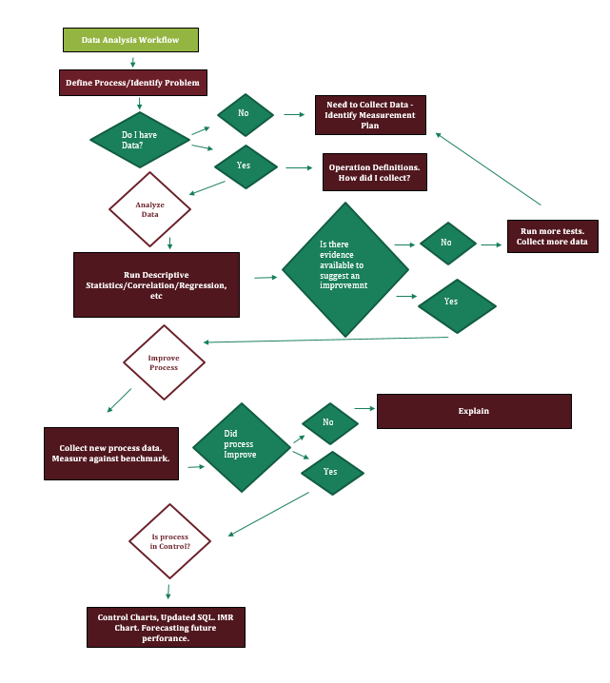

Increasing Conversion Rates amongst Programmatic Online Display Efforts
Process owner: Jacob Dineen
Key Dates --->
Team Launch
January 10th
Define
January 20th
Measure
Jan 10th-Feb 5th
Analyze
Feb 5th/6th
Improve
Feb 6th- Feb 26th
Control
Ongoing
Process improved.
+ $3600/Month.
6% Increase in Conversion Rate
DEFINE
MEASURE
ANALYZE
IMPROVE
Conversion Rate
Mean | 0.054695725
Standard Error | 0.004013695
Median | 0.055988315
Mode | #N/A
Standard Deviation | 0.020068477
Sample Variance | 0.000402744
Kurtosis | 0.427314139
Skewness | 0.781830668
Range | 0.077373131
Minimum | 0.029200574
Maximum | 0.106573705
Sum | 1.367393132
Count | 25
Problem/Definition
Low conversions rates on the identified platform. I would deem any positive direction a success, but because there is a standard deviation present in the daily data, I will shoot for somewhere between a 10-20% increase in mean conversion rate, using historical data from the previous month as a benchmark. For example, I am currently generating around a 5% conversion rate day over day, meaning that my ads are driving 5 out of 100 people to engage not only with the ad, but with the designated landing page they click through to. If I could influence that final conversion rate by 10%-20%, I would see an increase to 5.5% or 6%, overall.
Business Impact
If my conversion rate increases by 10%, there is a direct impact on the cost per individual conversion. The impending impact would result in 10% more dollars to spend during any given month to pursue further leads- This equates to roughly 6,000$ per month.
Problem and impact on business if process is improved. Measuring continuous data.
Average conversion rate, at a daily level, increased 6%. Perhaps more important than my average are the additional statistics noted above, such as min/max, range, and standard deviation. These metrics all moved in a more positive direction that indicates my process isn’t quite as wonky, and my output should be more predictable moving forward.
Eliminate bad predictor variables. Isolate key performance driving variables and shift weight towards them
Device Type: Shift a majority of spend into PC.
Ad Format/Size: Shift a majority of spend into 300x250 and 728x90 ad sizes.
Fold: Shift a majority of spend into ‘Above the Fold’
Defect = Conversion Rate < Average Conversion Rate of each process
Identified Critical Inputs and Outputs to Measure. Chi Squared test showed relationship prevalent between ad size/device type and performance
Process is in control/within limits.
Control
SQL: 2.7
Yield: 88.50%
Examined process and determined statistical relevance/sample
SQL: 2.8
Yield: 90.30%
UCL: 8.50%
LCL: 3.16%
Descriptive, Chi Square, Correlation, Regression, Time Series Used. Variable Relevance determined.
Process is within upper and lower control limits. 6% increase in conv. rate nets $3600 extra per month for media spending.
TEAM MEMBERS
Jacob Dineen – Realworld Inc.

